Slide 1
Welcome!
5th Grade Field Trip Information Night

Slide 2
Packets of information
PINK,
ORANGE
BLUE, YELLOW, GREEN
WHITE
Parent Letter (return bottom portion to teacher by 10/28)
Overnight Field Trip Privilege Requirements (next slide)
Dates of trip:
March 30 – March 31
3 forms to be returned to the teacher
Health Form
Activity Disclosure and Permission
CCSD Overnight Field Trip Form
Return all forms to teacher by 10/28
Rules of Conduct
Letter and packing list

Slide 3
Overnight Field Trip Privilege Requirements
Earned the Privilege | On the Fence | Did Not Earn the Privilege
5 or Fewer Absences | 6 or More Absences(whether or not they were excused and notes were sent in will be considered) | 10 or More Absence (unless they are due to health and have been excused)
Completed Assignments | Incomplete Assignments 1-5 assignments | More than 5 incomplete assignments
No Office Referrals | 2 or less office referrals | 3 or more office referrals
If students fall under the third column in any of the 3 areas or fall under 2 or more in the second column, they will need to go before the fifth grade teachers to present why they should be allowed to attend the overnight field trip.
All paperwork must be turned in by October 28th for students to go on the overnight field trip.
A deposit or arrangement with Mrs. Kee must be done by October 28th for students to go on the overnight field trip.

Slide 4
Why have an
overnight field trip?
To provide a very memorable experience for our students.
To take our students somewhere they have never been.
To meet some of our Science and Social Studies standards.
We have had much success with this trip over the past four years. Many other Cobb County elementary schools attend trips such as this (and have for many years)!
We feel this group of students can handle this type of trip.

Slide 5
Previous 5th grade field trips
2015 - 16 Blue Ridge $100 for 32 hours
2014 – 15 Blue Ridge $100 for 32 hours
2013 – 14 Blue Ridge $100 for 32 hours
2012 – 13 Blue Ridge $110 for 32 hours
2011 - 12 Stone Mountain $50 for 9 hours
2010 - 11 Stone Mountain $45 for 9 hours
2009 - 10 Fernbank $34 for 8 hours
2008 - 09 Georgia Aquarium $41 for 9 hours

Slide 6
So what does the cost include?
4 Meals
Lunch
Dinner
Breakfast
Lunch
3 Class programs
2 day programs
1 night program
Snack during the night program
Lodging in the cottages
His Majesty charter busses to and from Blue Ridge!
Total cost is $110 per student Different payment options are available
Leave Lewis at 8:00 A.M. on March 30 and return by 4:00 P.M. on March 31

Slide 7
Join us for special 5th grade nights
October 11th
November 15th
January 17th
February 16th
Make sure to tell them you are with Lewis Elementary.
Stevi B’s will donate funds to Lewis to help offset the cost of our trip!!!!!!!!

Slide 8
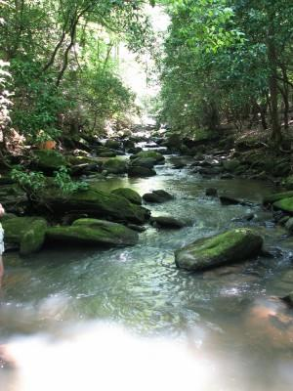
Blue Ridge Outdoor Education Center
480 beautiful acres, owned by the Episcopal Diocese of Atlanta, this is a place where nature touches all of your senses in its warm embrace.
Ecologically speaking, our location is unique. Blue Ridge is nestled in the transitional zone between the Piedmont and the Appalachian Mountains and richly blessed with the flora and fauna of both regions. We have more than 30 species of trees, abundant wildflowers and herbaceous species, providing habitat for a healthy community of mammals, birds, reptiles and amphibians. This diversity is spread out over 480 acres of forested ridges and shaded coves, including a wetland, waterfall and a trout stream. The inviting landscape and unusual ecosystems make Blue Ridge a rich learning environment.

Slide 9
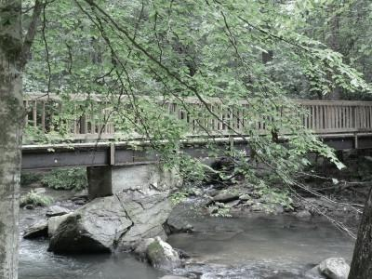
Blue Ridge Outdoor Education Center offers students of all ages the chance to see and touch the processes at work in the world around us and to get a sense of their special place in that system through environmental education. We regard environmental education as a process of opening awareness and gaining knowledge of our world. Building on this philosophy, we teach critical thinking and problem-solving skills to challenge learners to grow into active citizens and conscious stewards of the land that nourishes us all.

Slide 10
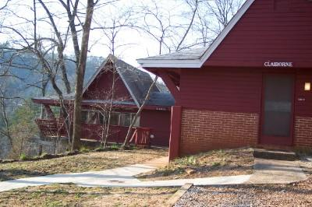
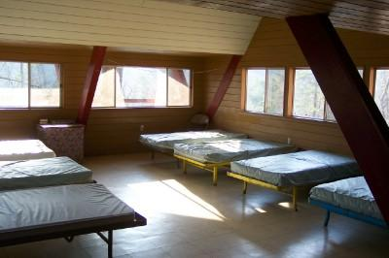
The Cottages

Slide 11
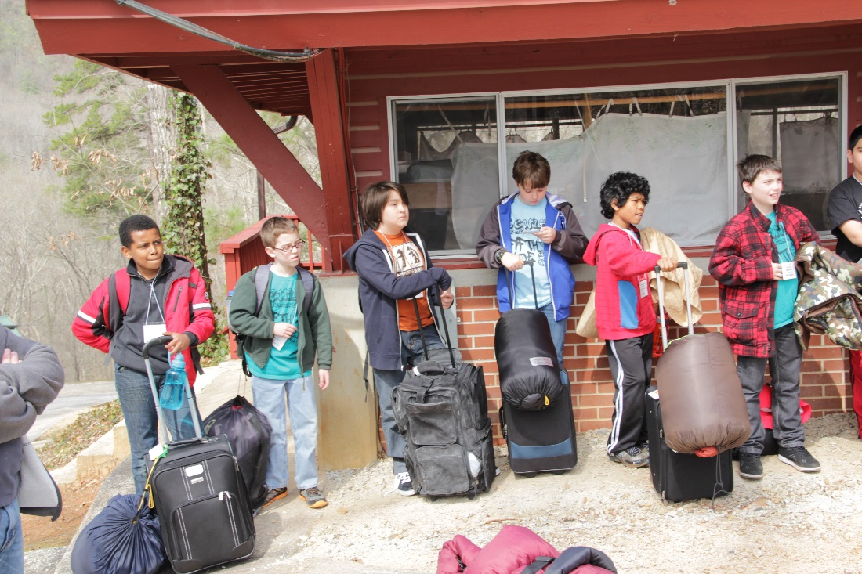
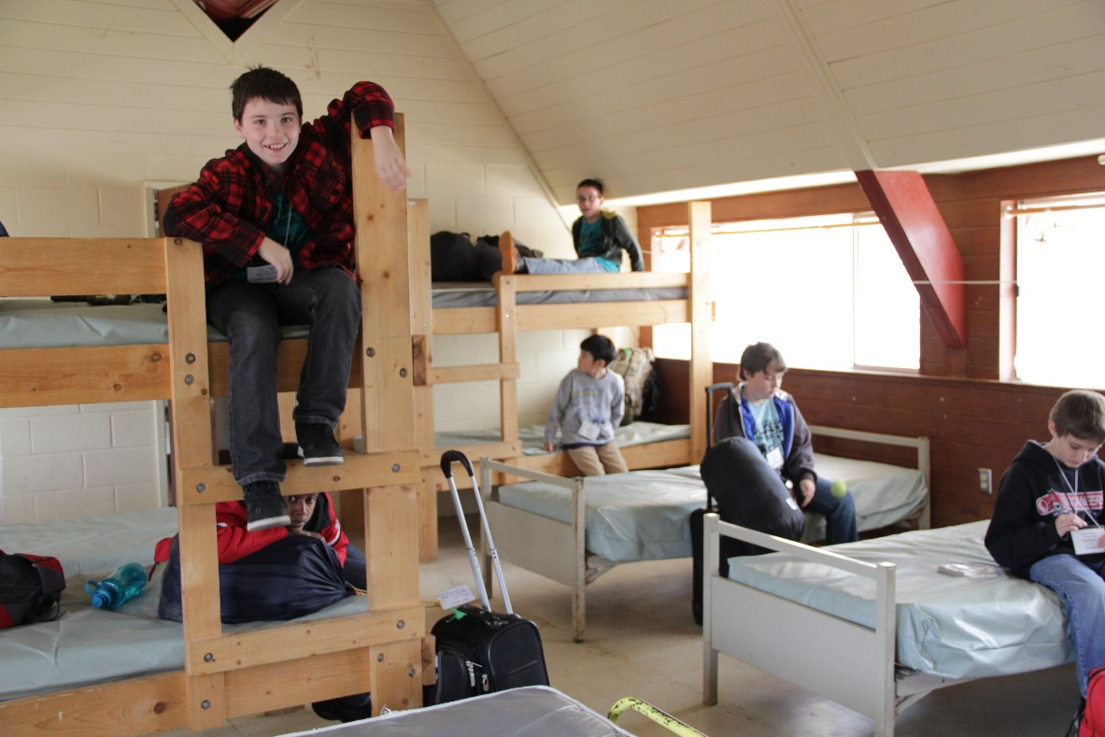

Slide 12
Students will be divided into two groups:
“Cottage Group”. This group is either all boys or all girls. This is the group they will be with in their cottage at night. Female chaperones will be with the girl groups and male chaperones will be with the boy groups. These groups have about 8 – 10 students (usually students in the same classroom here at Lewis) with 2 or 3 adult chaperones.
“Field Group”. These groups are mixed boy/girl. These are the groups that stay together for the day and evening classes. These groups are a little larger (about 15 students with 4 or 5 adult chaperones).
Mark your calendar for final meeting on March 7, 2017 at 6:30. You will find out your parent chaperones/groups at this meeting.

Slide 13
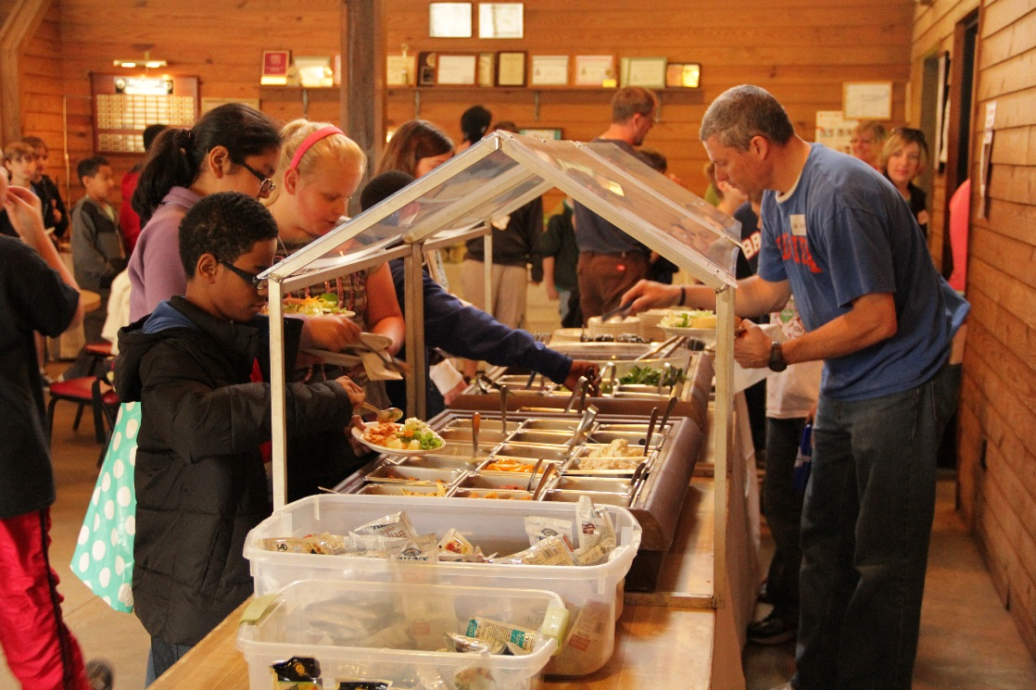
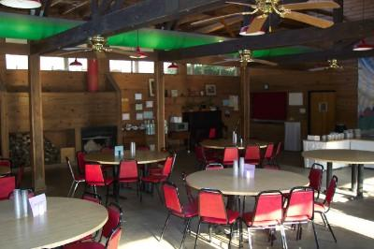
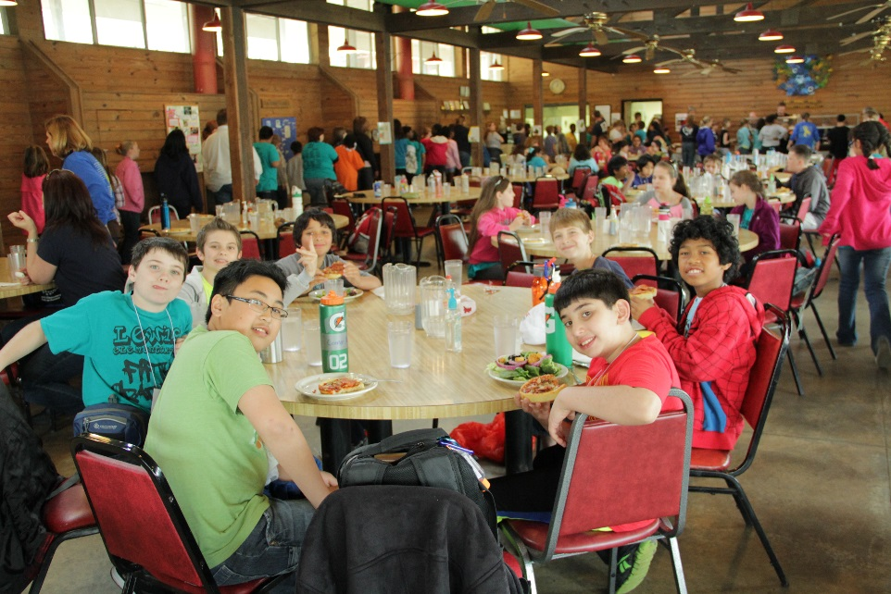
The Dining Hall

Slide 14
Day Classes
Some of the choices are:
Sustainability
Geodome
Outdoor Living Skills
Who Gets This Land?
Appalachian Geology Hike
Animal Ecology
Forest Ecology
Aquatic Ecology

Slide 15
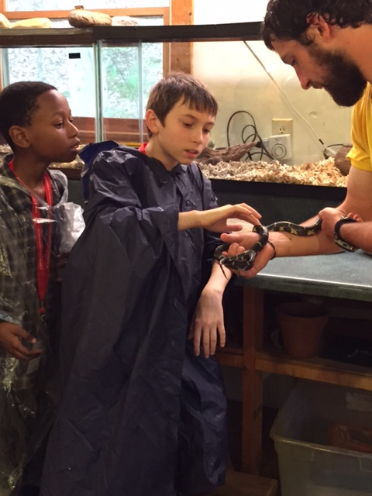
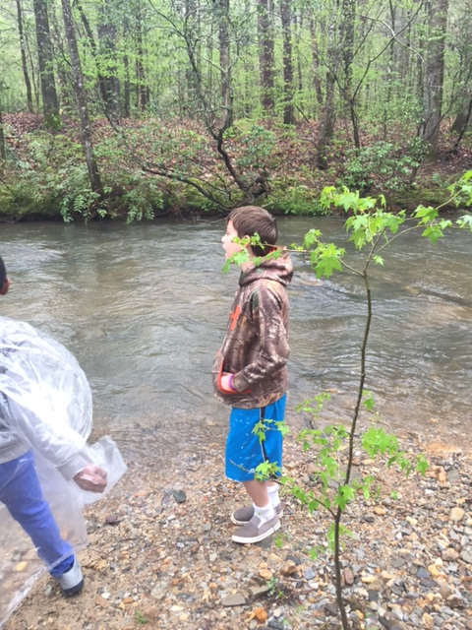
Pictures from last year…
Animal Ecology

Slide 16
Night Class:
Some of the choices are:
Campfire, Skits, & S’mores
Appalachian Culture
Owl Prowl
Night Walk

Slide 17
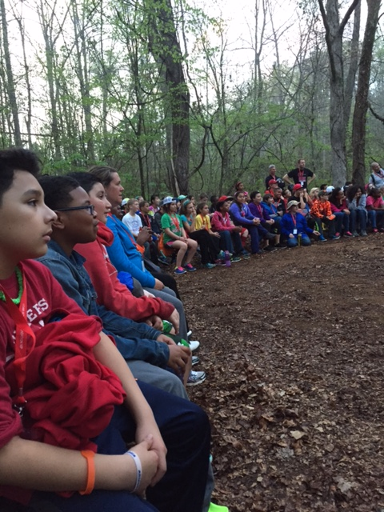
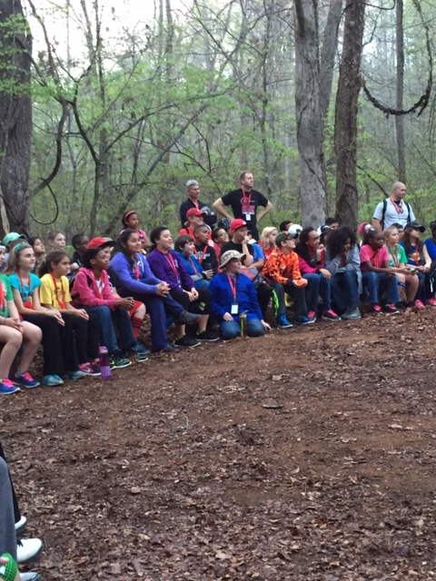
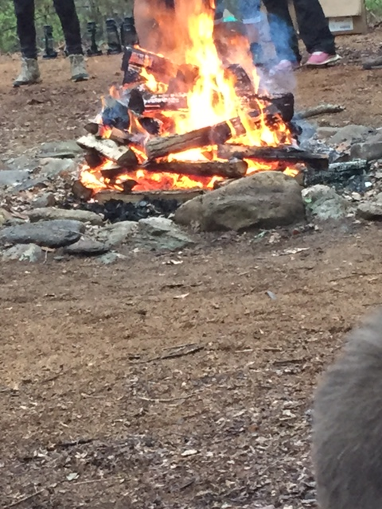
Pictures from last year’s evening class

Slide 18
We must send in a deposit soon to secure our busses and lodging.
Please pay ASAP.
Any student attending the trip must pay at least $27.50 by 10/28.
Payment envelopes are available tonight.

Slide 19
Chaperones!
All 5th grade teachers as well as Mrs. Kee, Mrs. Monstrola, Mr. Sproat, Mr. Grebe, and Mr. Smith will be going plus a parent or two per classroom. We need a chaperone who is Registered Nurse to go as well. Approximately 4 chaperones will be assigned to each classroom.
Chaperones will be notified by Winter Break and a meeting will be set up with chaperones prior to the trip.

Slide 20
Questions?

